Slide 1



Fake News Analysis
Brian Pan

Slide 2
Table of Contents
Unigrams Analysis
Bigrams Analysis
Trigrams Analysis
WordCloud Analysis
Word Frequency Analysis
Video
Note: Text Vectorizations will be explained in markup form within jupyter notebook file (ipynb) file.

Slide 3
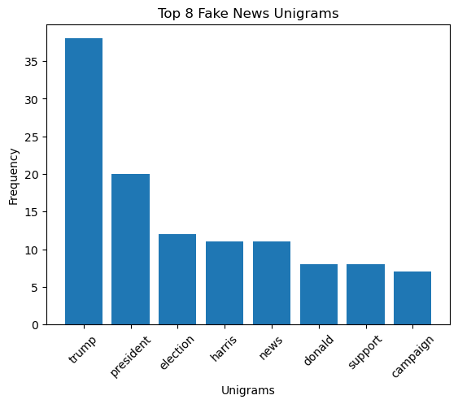
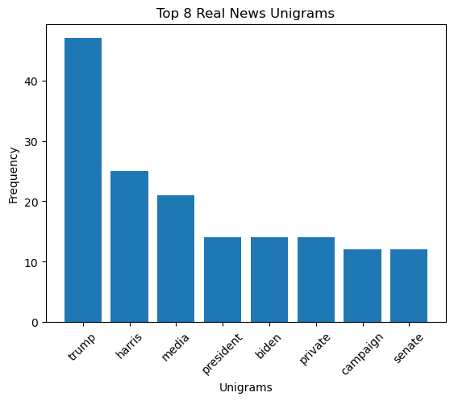
Unigrams

Slide 4










Unigrams
Similarities
There is high mention of Trump, Harris, the campaign, and interestingly, also of the media/news.

Slide 5

Unigrams
Differences
Mention of Biden in real news seems to acknowledge that the presidential campaign retains influence from Biden.
Additional terms private and senate from real news suggest further specialized details not found in fake news.

Slide 6
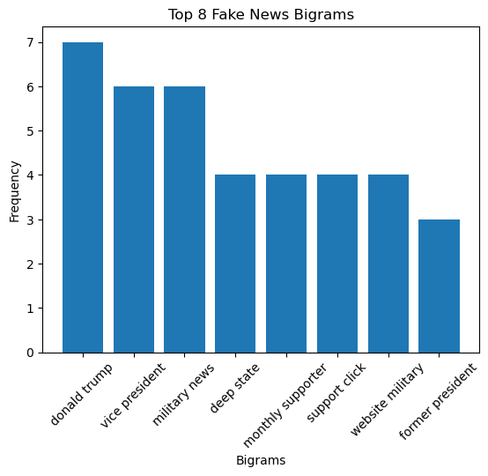
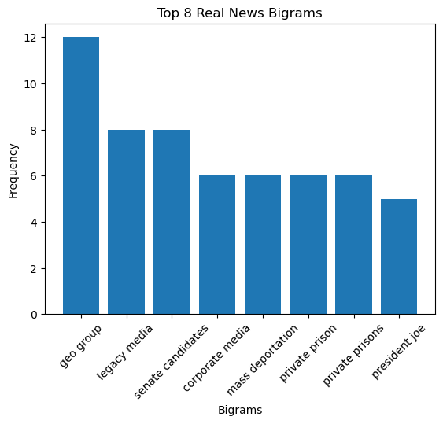
Bigrams

Slide 7
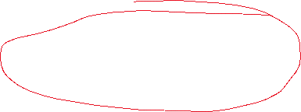
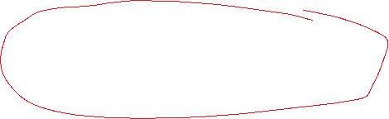
Bigrams
Similarities
Noticeable break from the unigrams, these two charts diverge on all aspects.

Slide 8






Bigrams
Differences
Fake news emphasizes power dynamics with terms like deep state and military
Real news incorporates detailed bigrams including many current issues like geo group, mass deportation, and private prisons

Slide 9




Bigrams
Differences
References to titles are retained. Trump is addressed in his full name.
Trump disappears from bigrams. This may signal that most references are in third person.
Interesting to note that President Joe comes up often.

Slide 10
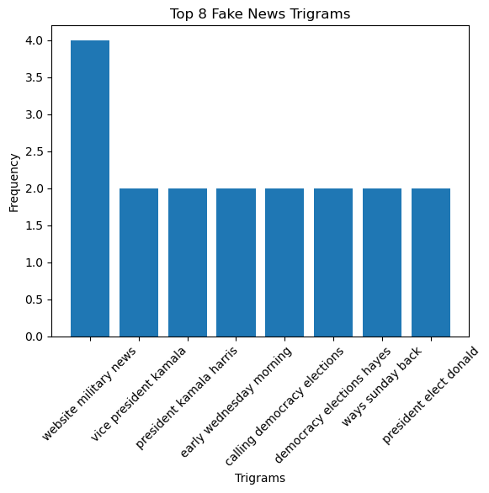
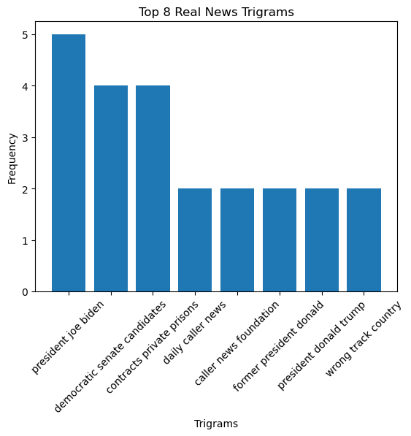
Trigrams

Slide 11




Trigrams
Similarities
Certain 4-grams come up. Here is
Vice President Kamala Harris
Certain 4-grams come up. Here is
Former President Donald Trump

Slide 12




Trigrams
Differences
Main difference is the power dynamics in fake news, whereas real news has layers of details.
Here mentions President Joe Biden, Democratic Senate candidates, and contract private prisons.

Slide 13
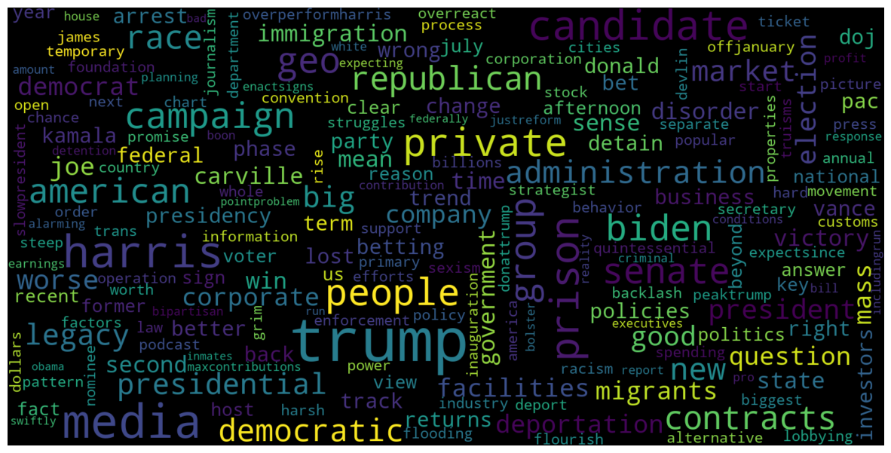
WordCloud – Real News

Slide 14
WordCloud – Real News
Notable words include:
Trump
Prison
Harris
Candidate
Biden
Republican
Campaign
Democratic
Media
Contracts
Senate
Geo
Group
American
People

Slide 15
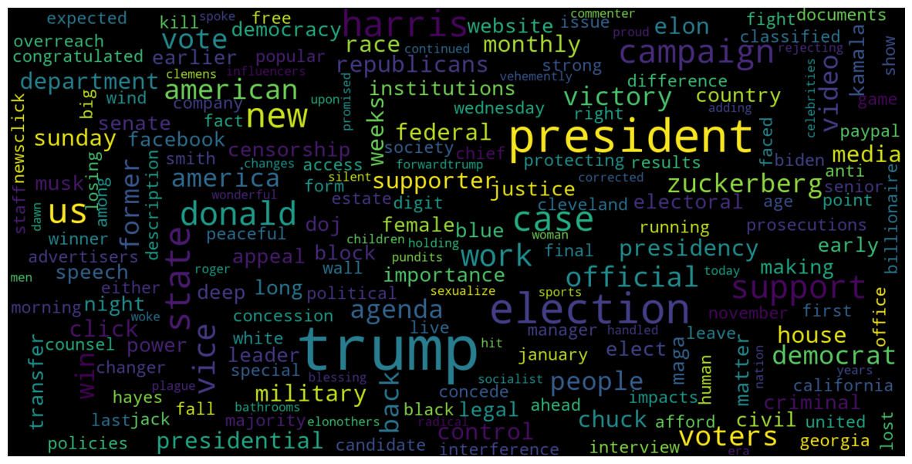
WordCloud – Fake News

Slide 16
WordCloud – Fake News
Notable words include:
Trump
President
Election
Campaign
Harris
Donald
Vice
State
New
Voters
Support
US

Slide 17
Wordcloud
Noticeable Differences
Harris has been de-emphasized in Fake News
Trump retains similar or equal emphasis in both Fake News and Real News
Less words are as pronounced in Fake News than Real News
Both news highlight major current events like the election campaign
Real News has more detailed terms like Geo Group, Contracts, and Prison

Slide 18
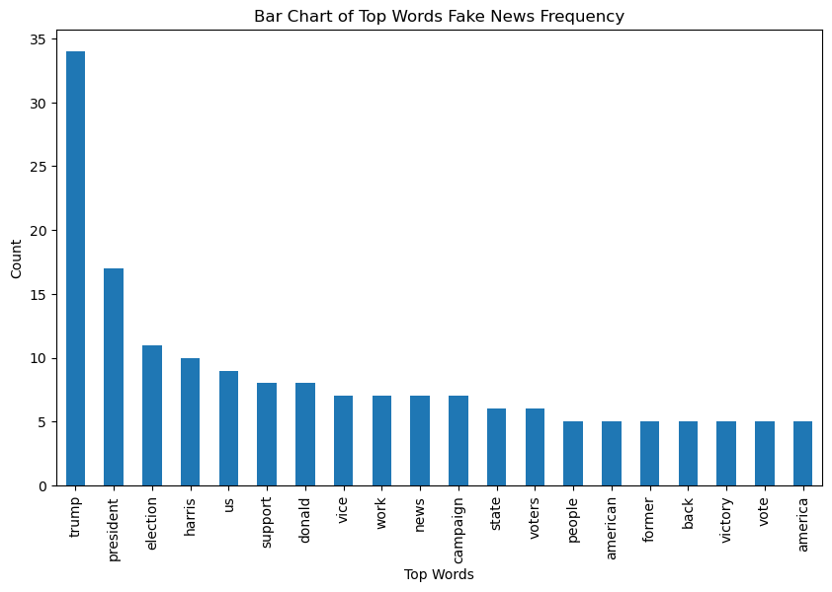
Word Frequency

Slide 19



Word Frequency
Most terms do not appear more than 10 times
Trump has the most mention by more than 3x the other words
Next highest word is president, either referencing the campaign or as a title for Trump.
Note that Biden is not present in this chart
Biden?

Slide 20
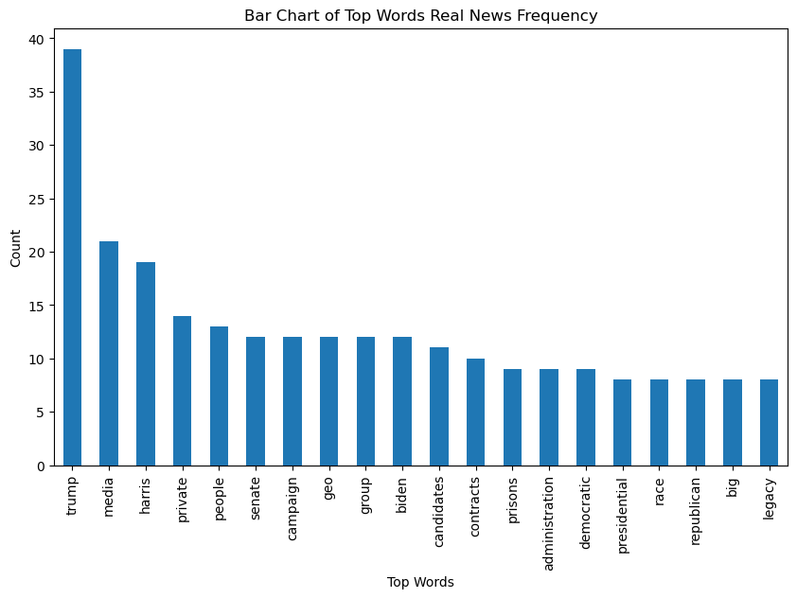
Word Frequency

Slide 21



Word Frequency
Most terms occur around 15 times
Trump still appears the most at a similar frequency
Media is second most frequent term, appearing around half as much as Trump
Emphasis on magnitude with big and legacy

Slide 22
Summary of Findings
 | Unigrams | Bigrams | Trigrams | WordCloud | Frequency Chart
Fake News | Nothing outside primary election | Mentions power dynamics ‘military’, ‘deep state’. Emphasizes titles like ‘vice president’ | Mentions ‘website military news’ | Fewer words stand out. Little mention of terms outside of campaign-election. | Sole emphasis on Trump. No mention of issues. No mention of Biden.
Real News | Mentions ‘Biden’, ’senate’,’private’ | Issues like ‘mass deportation’, ‘private prison’, ‘mass deportation’ | Mentions ’President Joe Biden’, ‘democratic senate candidates’,’contracts private prison’ | More words stand out. More mention of key issues. | Emphasis on ‘media’ and ‘harris’. Other terms are more pronounced.
Both | Mention of election and campaign | No similarities | Address candidates by their current title | ‘Trump’ mentioned at similar frequency | ‘Trump’ is the leading term

Slide 23

Analysis
 | Fake News | Real News
Topics | Emphasis on major current events. | Has a good mix of events and issues.
Persons | Only key individuals are mentioned. Big personalities like ‘Trump’ are emphasized. | Mentions all parties relevant to the issue/news.
Content | Appeal to universal issues like power | Attempts to paint a more cohesive picture of issues at hand
Substance | Little details | A lot of details

Slide 24

Identifying Fake News
Fake News tend to have little substance. This is likely to happen because details provide challenges to its authenticity. As the content becomes more detailed, it gets more susceptible to being fact checked.
Fake News do not have a variety of topics. Targeting a few key topics with a high audience base is more effective to disseminating false information. Specialized content are unlikely to attract much attention.
Fake News attempts to sway emotions. While there is an emotional appeal for real news as well, it is not as obvious.
Fake News attempts to capitalize on major personalities. This is likely because there is strong appeal for the average reader to be curious and interested in famous personalities.

Slide 25
Additional Links
https://scikit-learn.org/1.5/modules/generated/sklearn.feature_extraction.text.TfidfVectorizer.html
https://kavita-ganesan.com/tfidftransformer-tfidfvectorizer-usage-differences/
https://stackoverflow.com/questions/17839973/constructing-dataframe-from-values-in-variables-yields-valueerror-if-using-all
https://scikit-learn.org/dev/modules/generated/sklearn.neighbors.KNeighborsClassifier.html#sklearn.neighbors.KNeighborsClassifier
https://stackoverflow.com/questions/74406936/knn-python-implementation

